Slide 1
Living for What Really Matters
Ecclesiastes 12:1-8, 13-14
Dr. Lewis Winkler
Uploaded by Dr. Rick Griffith • Crossroads International Church Singapore
CICFamily.com • BibleStudyDownloads.org

Slide 2
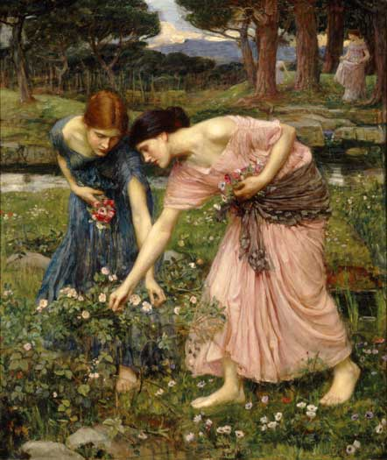
“To the Virgins, to Make Much of Time”
By Robert Herrick (1591-1674)
Gather ye rose-buds while ye may,
Old time is still a flying:
And this same flower that smiles today,
Tomorrow will be dying

Slide 3
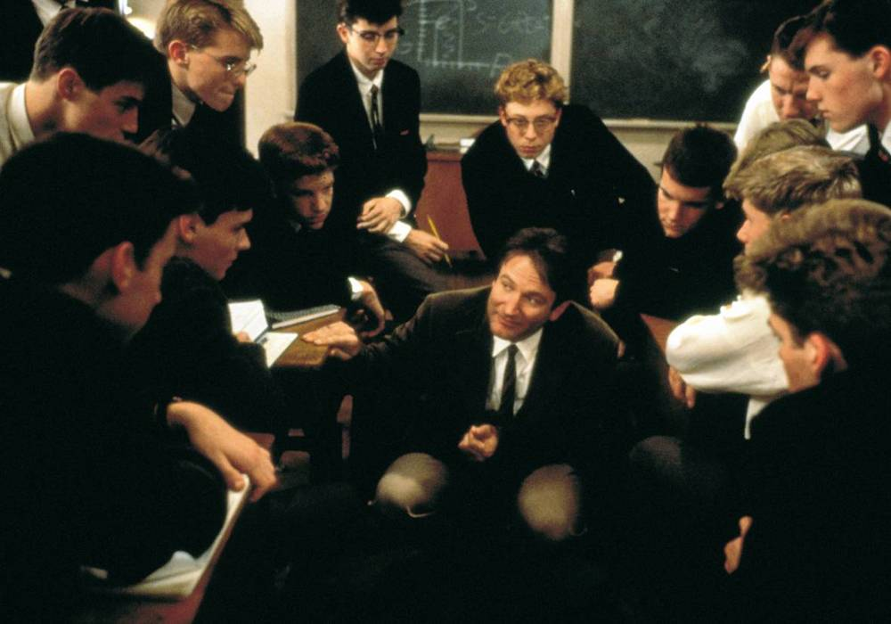
Carpe Diem
Seize the day!

Slide 4
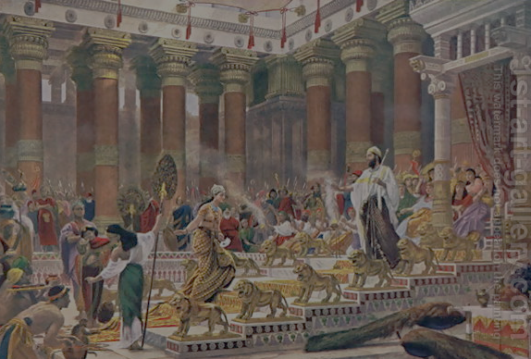
Traditionally Attributed to Solomon
Unmatched Wisdom (1 Kings 3:5-12; Ecclesiastes 1:16-18)
Unlimited Pleasure (1 Kings 11:3; Ecclesiastes 2:1-3, 8)
Unprecedented Achievements (1 Kings 6-7; Ecclesiastes 2:4-6)
Untold Wealth (1 Kings 10:14-29; Ecclesiastes 2:7-8)
Unbounded Power (1 Kings 4:21; Ecclesiastes 2:9)

Slide 5
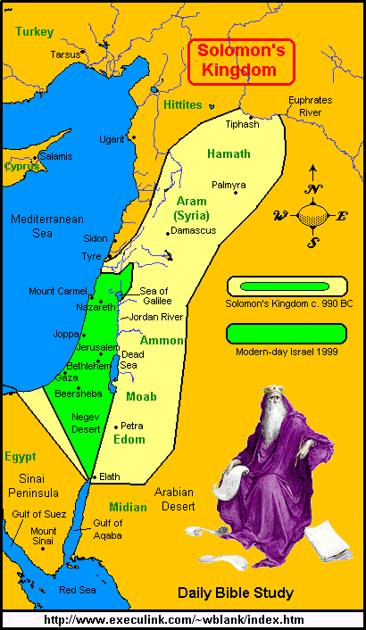
The Extent of Solomon's Reign

Slide 6
Traditionally Attributed to Solomon
Unmatched Wisdom (1 Kings 3:5-12; Ecclesiastes 1:16-18)
Unlimited Pleasure (1 Kings 11:3; Ecclesiastes 2:1-3, 8)
Unprecedented Achievements (1 Kings 6-7; Ecclesiastes 2:4-6)
Untold Wealth (1 Kings 10:14-29; Ecclesiastes 2:7-8)
Unbounded Power (1 Kings 4:21; Ecclesiastes 2:9)
Unbelievable Fame (1 Kings 10:1-13)

Slide 7
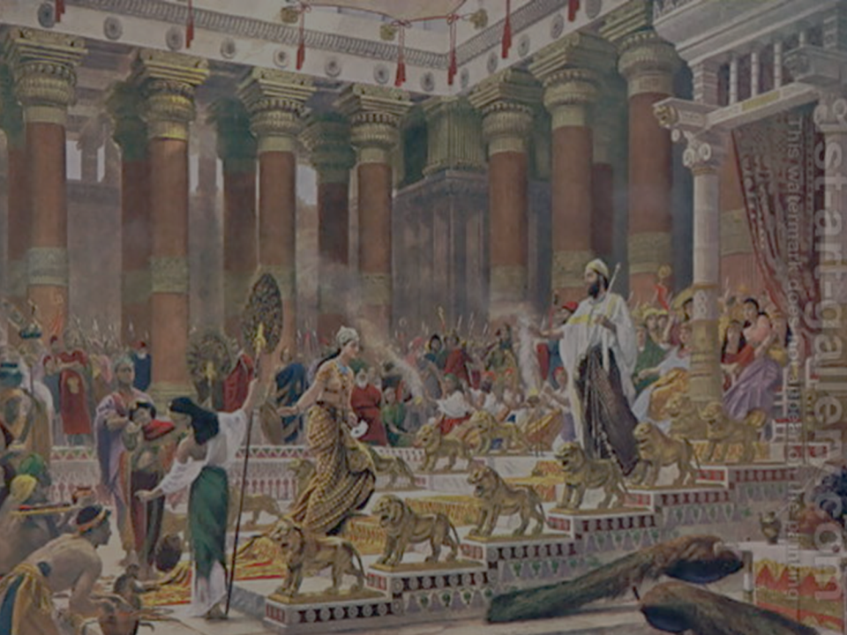
The Queen of Sheba's Assessment:
“The report was true that I heard in my own land of your words and of your wisdom, but I did not believe the reports until I came and my own eyes had seen it. And behold, the half was not told me. Your wisdom and prosperity surpass the report that I heard.”

Slide 8
Remember God before it is too late (Ecc. 12:1-8).
Before You Can No Longer Enjoy Living (1)

Slide 9
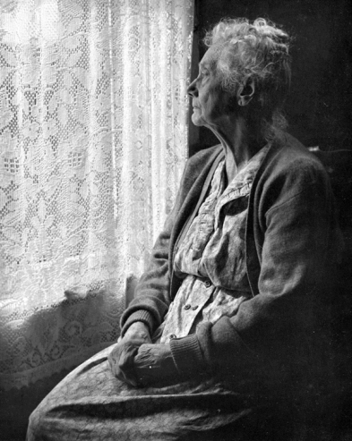
Remember God before it is too late (1-8).
Before You Lose Your Sight (2-3)

Slide 10
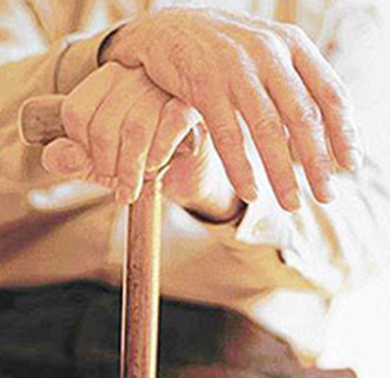
Remember God before it is too late (1-8).
Before You Lose Your Sight (2-3)
Before You Lose Your Strength (3, 5)

Slide 11
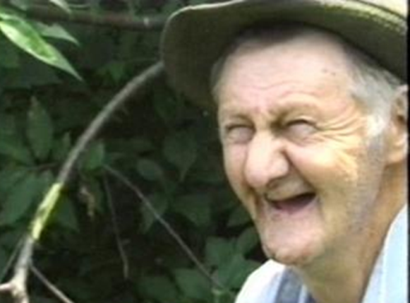
Remember God before it is too late (1-8).
Before You Lose Your Sight (2-3)
Before You Lose Your Strength (3, 5)
Before You Lose Your Teeth (3)

Slide 12
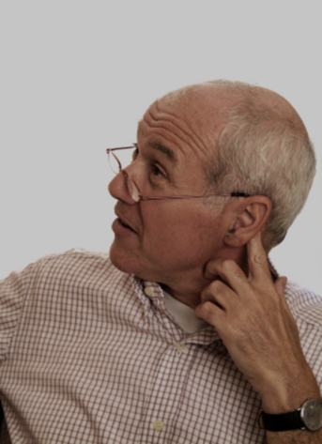
Remember God before it is too late (1-8).
Before You Lose Your Sight (2-3)
Before You Lose Your Strength (3, 5)
Before You Lose Your Teeth (3)
Before You Lose Your Hearing (4)

Slide 13
Remember God before it is too late (1-8).
Before You Lose Your Sight (2-3)
Before You Lose Your Strength (3, 5)
Before You Lose Your Teeth (3)
Before You Lose Your Hearing (4)
Before You Lose Your Libido (5)

Slide 14
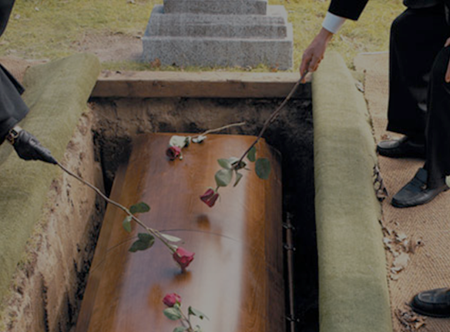
Remember God before it is too late (1-8).
Before You Lose Your Sight (2-3)
Before You Lose Your Strength (3, 5)
Before You Lose Your Teeth (3)
Before You Lose Your Hearing (4)
Before You Lose Your Libido (5)
Before You Lose Your Life (5-7)

Slide 15
What does “vanity” or “meaningless” mean in verse 8?
The key word is hebel.
Meaningless?
Vanity?
Futility?

Slide 16
What does “vanity” or “meaningless” mean in verse 8?
The key word is hebel.
Meaningless?
Vanity?
Futility?
It comes from the root word, “vapor.”

Slide 17
What does “vanity” or “meaningless” mean in verse 8?
The key word is hebel.
Meaningless?
Vanity?
Futility?
It comes from the root word, “vapor.”
Vapor is something, but it is fleeting and impossible to capture or hold onto.

Slide 18
What does “vanity” or “meaningless” mean in verse 8?
“You do not know what your life will be like tomorrow. You are just a vapor that appears for a little while and then vanishes away.”
—James 4:14

Slide 19
What does “vanity” or “meaningless” mean in verse 8?
We might translate verse 8 like this:
“'Vapor of vapors,' says the Preacher; 'all is vaporous.'”
Or more loosely:
“'Utterly fleeting,' says the Preacher; 'everything is fleeting.'”

Slide 20
Ecclesiastes 12:1-8: A Basic Summary
It's tough to grow old, and it makes enjoying all that life has to offer much more difficult.
Old age will sneak up on us more quickly than we realize.
Therefore, we should remember God while we are still young.

Slide 21
“Ozymandias”

Slide 22
“Ozymandias”
by Percy Shelley
I met a traveler from an antique land
Who said: Two vast and trunkless legs of stone
Stand in the desert. Near them, on the sand,
Half sunk, a shattered visage lies, whose frown
And wrinkled lip, and sneer of cold command,
Tell that its sculptor well those passions read
Which yet survive, stamped on these lifeless things,
The hand that mocked them and the heart that fed;
And on the pedestal these words appear:
“My name is Ozymandias, king of kings:
Look on my works, ye Mighty, and despair!”
Nothing beside remains. Round the decay
Of that colossal wreck, boundless and bare
The lone and level sands stretch far away

Slide 23
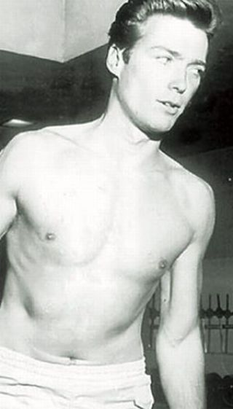
Some Celebrity Heartthrobs: Clint Eastwood

Slide 24
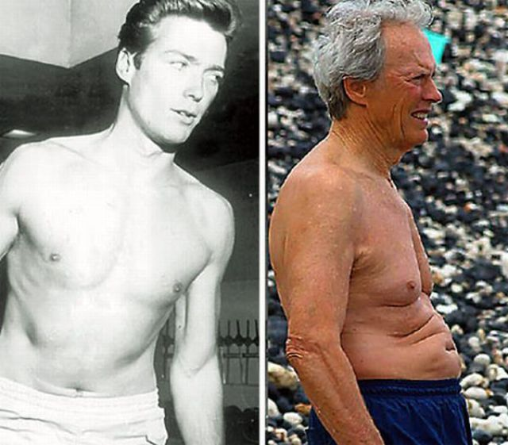
Some Celebrity Heartthrobs: Clint Eastwood

Slide 25
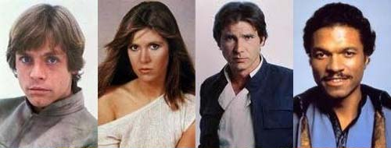
The Cast from Star Wars:

Slide 26
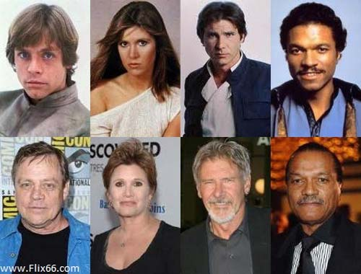
The Cast from Star Wars:

Slide 27
Why do we age?
God uses it to discourage us from loving this world too much.
God uses it to make us face our mortality and not ignore the inevitability of death.

Slide 28
Psalm 90:10, 12
The years of our life are seventy, or even by reason of strength eighty; . . . they are soon gone, and we will fly away . . . . So teach us to number our days that we may get a heart of wisdom.

Slide 29
Some Honest Self-assessment:
Are you honestly facing the reality of your own mortality?
Do you really believe your life will pass quickly?
What things tend to keep you from remembering these important truths?

Slide 30
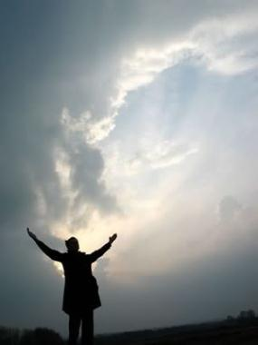
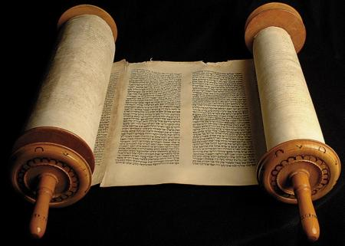
Live in light of God's judgment (13-14).
Solomon's conclusion is this:
Fear God and keep His commandments.

Slide 31
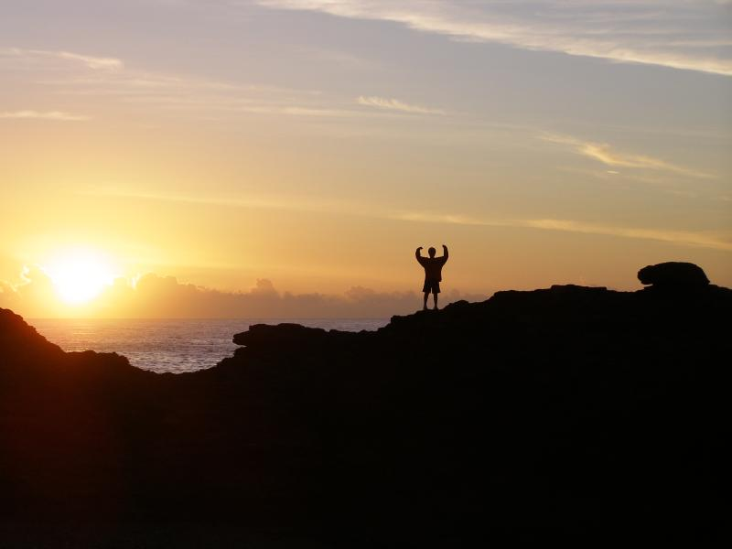
Live in light of God's judgment (13-14).
Solomon's conclusion is this:
This is what God expects from all of us.

Slide 32
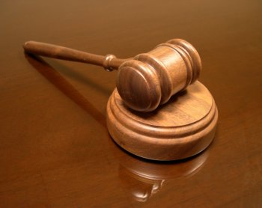
Live in light of God's judgment (13-14).
Solomon's conclusion is this:
God will judge us for how we live our lives.

Slide 33
Two Crucial Truths:
All the things that we are told by the world will make us happy will not ultimately satisfy our deepest longings.
The choices that we make early in life take us down certain pathways and set us on trajectories that we may not be able to change or reverse later on in life.

Slide 34
Sowing and Reaping:
Sow a thought, reap an action.
Sow an action, reap a character.
Sow a character, reap a destiny.

Slide 35
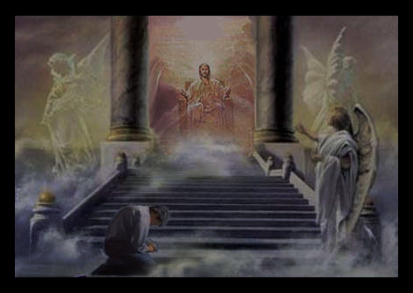
As Christians we will also be judged by God.
“For we must all appear before the judgment seat of Christ, so that each one may receive what is due for what he has done in the body, whether good or evil.”
—2 Corinthians 5:10

Slide 36
Big Idea:
Serve God now because your life will be over before you know it, and He will judge you for how you chose to live it.

Slide 37
Some Honest Self-assessment:
Are you genuinely living your life in view of eternity and God's righteous judgment?
Is there some area of your life that needs to be redirected or changed?
If so, what specifically needs to change, and how will you make that change?

Slide 38
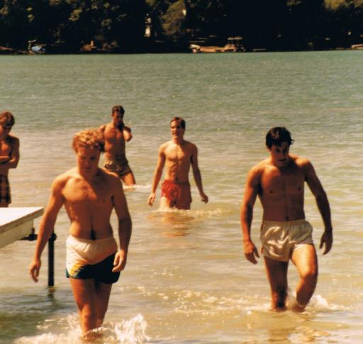
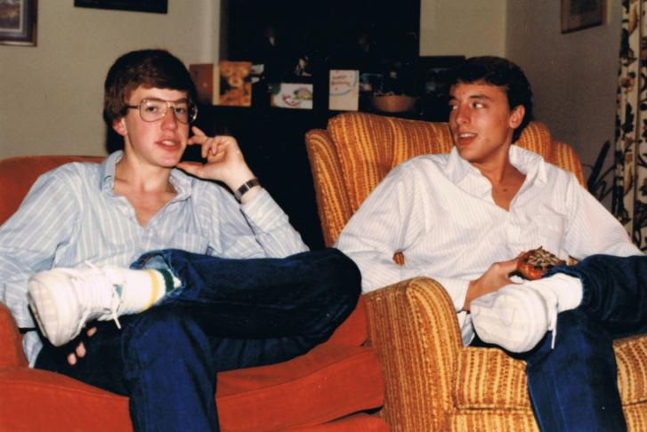
A Tale of Two Fraternity Brothers
Mike Bergman and John Martin

Slide 39
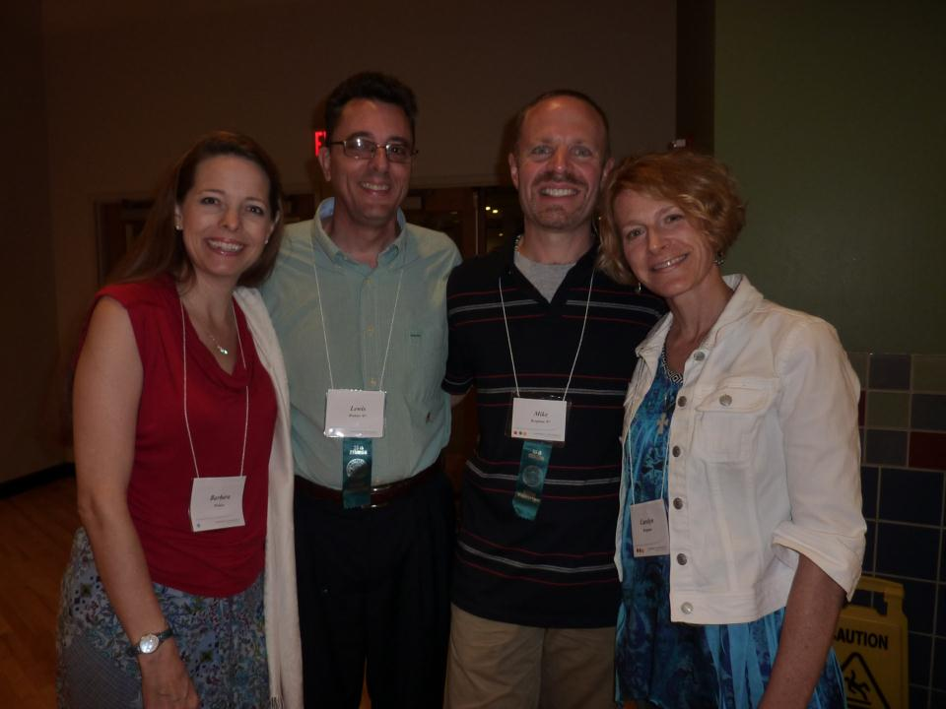
Mike Bergman Now
“Pray that I would truly delight myself in the Lord and not in my circumstances or the things of this world.”

Slide 40
Black

Slide 41
OT Preaching link at BibleStudyDownloads.org
Get this presentation and script for free!

